Slide 1

CS 533 INTRO TO DATA SCIENCE
Michael Ekstrand

Slide 2
CHARTS FROM THE GROUND UP

Slide 3

Learning Outcomes
Design a chart by thinking first of the questions, goals, and data
Photo by Ryan Quintal on Unsplash

Slide 4
What is the Question?
What question do we want to answer?
How, precisely, did we operationalize it?
What data are we using?
Specifically, variables

Slide 5
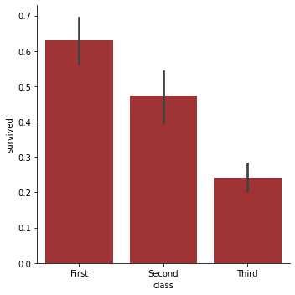
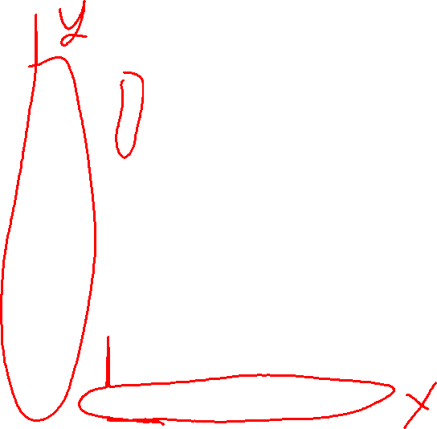
Example: Titanic Survival
Bar chart
Question: were passengers in higher classes more likely to survive?
Outcome variable: survival
Logical variable, 0/1 encoded
Taking mean yields numeric response!
Mean is probability of survival (1)
Also called response variable or dependent variable
Explanatory variable: passage class
Categorical
Also called independent variable

Slide 6
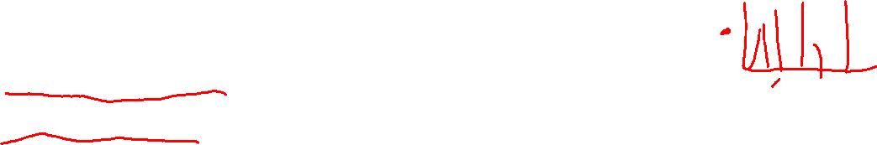
Showing Relationships
Most plots show how a numeric variable changes between different values of one or more other variables.
What is the variable to show?
What do we want to show about it?
Value?
Statistic?
Distribution?
How do we want to compare between EV values?
Even histograms follow this!
Outcome: frequency (count, proportion, density)
Explanatory: value or bin

Slide 7
Pipeline
Identifying these informs:
Data processing (e.g. binning, group-aggregate, transform)
Choice of plot type
Axes, labels, colors, facets

Slide 8
Variable Types
Response is numeric (or transformed to be)
Categorical → relative frequency
Explanatory can be anything
Numeric → continuous axis
Categorical → discrete axis
Ordinal → discrete axis preserving order; may omit some labels

Slide 9
One Explanatory Variable
If EV is continuous: scatter or line
Scatter plots we sometimes blur response/explanatory
If EV is discrete:
Bar chart shows statistic, emphasizing relative difference
Point plot shows statistic, emphasizing absolute difference
Box or violin plot shows distribution

Slide 10
Two Explanatory Variables
Pseudo-3D:
Contour plot
Identify peak(s) & shape
Good for 2 continuous explanatory variables
Heat map
See where high & low points are
Works for ordinal EVs

Slide 11
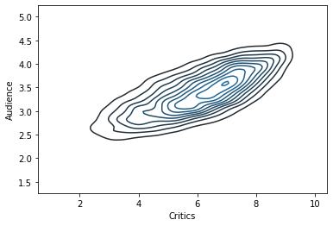
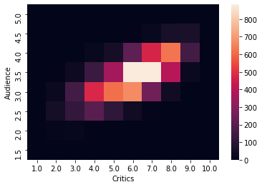

Demonstration

Slide 12
Two Explanatory Variables
Pseudo-3D:
Contour plot: identify peak & shape
Heat map: see where high & low points are
Other aesthetics for secondary variables:
color, shape, size
Occasionally used to indicate second response variable

Slide 13
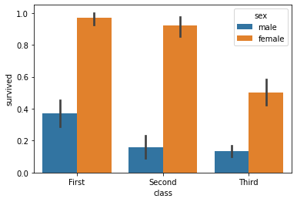
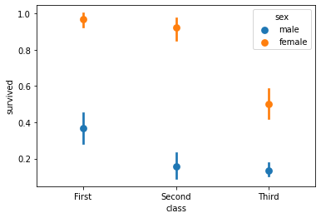

Titanic by Class and Sex

Slide 14
More than Two EVs
Can’t really have more than 1, maybe 2 numeric
Others can be binned
Facets let us break down the plot by more categorical explanatory variables.

Slide 15
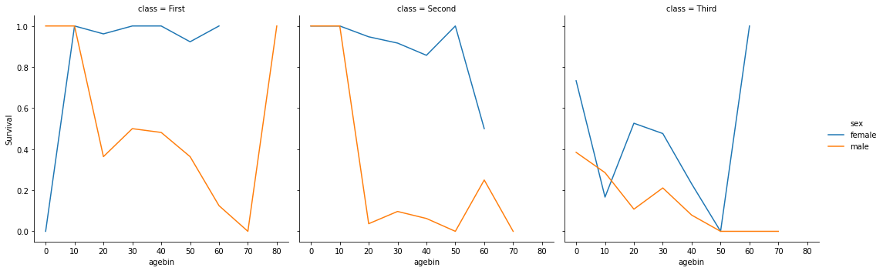

Facet Plot

Slide 16
Faceting
Built in to some Seaborn plot functions (row=, col=):
relplot
catplot
General-purpose: FacetGrid
Plotnine or ggplot2 (R): facet_grid or facet_wrap

Slide 17
More than Two EVs
Can’t really have more than 1, maybe 2 numeric
Others can be binned
Facets let us break down the plot by more categorical explanatory variables.
Pay attention to which variables go where. It strongly affects what readers compare.

Slide 18
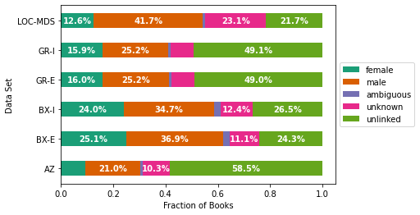

Stacking
Stacking lets us see differences in composition – how do the parts of a whole change?
Stacked bar charts
Stacked area charts
Can be either raw values or fractions.

Slide 19
Transformations
Sometimes we transform the axis
Log-10 scale – shows order of magnitude
Generally don’t do this to bars
Sometimes we transform the data
Rescale, log, square root
Bin

Slide 20
Key Decisions
Variables (and their transformations)
“Aesthetics” – mappings to chart features
x, y (axes)
row, col (faceting)
hue (color)
style (point marker style)
linetype (line type, e.g. solid or dashed)
Type – line, bar, point, etc.

Slide 21
Be Careful
Avoid excessive complexity
Be careful with color (easy to make indistuingishable)
A good graphic reveals the data, and does not distort or obscure

Slide 22

Wrapping Up
Identify variables and relationships you want to highlight.
Design a plot that illustrates them.
Study plotting library APIs.
Photo by Daniel Cheung on Unsplash

